Slide 1
LTC / STC planning can no longer be avoided as an important part of financial plans.
70% of people will require some type of care.
90% of adults have never had a real discussion about long term care planning.
61% of people surveyed said they would rather die than go into a Nursing Home.
Consumers are TERRIFIED they’ll end up in a Nursing Home. They are waiting for you to mention LTCi as an option to help KEEP THEM OUT of those facilities.
https://brokerworldmag.com/helping-clients-understand-the-cost-of-long-term-care-in-2022/

Slide 2
LTC – The Good Old Days
No - Go
People
Helped

Slide 3
2003 – Things Start To Change
No - Go
People
Helped

Slide 4
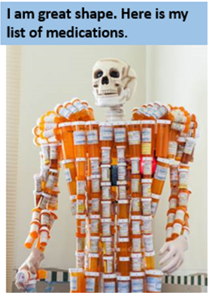
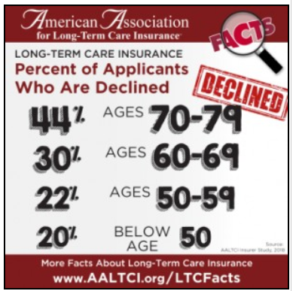
Where We Are Today…
No - Go
People
Helped

Slide 5
We Want to Take This…
People
Helped
No - Go

Slide 6
And Make It Look More Like This…
No-Go
People
Helped

Slide 7
It’s Time For A Paradigm Shift!
Skipping the meal altogether….
Versus
Setting the table and satisfying some….
Versus
Feeding just about everyone?

Slide 8
Say “Hello” To The Future of STC.…

Slide 9
Underwriting… Throw the Net Wide!
Contains 45 Rows of Groups of Health Questions that Cover Every Application UW Question from Eight of our Top Peripheral Plans…
CARRIER / PLAN | # OF THE 45 ROWS THAT ARE INSURABLE
GTL’s Short-Term HHC-Only Plan | 43 “YES” of 45 Rows
AETNA’s Home Care Plus (No Facility) | 35 “YES” of 45 Rows
Tier 1-$100/Day Max. | 33 “YES” of 45 Rows
Tier 2-FULL Benefits | 21 “YES” of 45 Rows
GTL’s Recover Cash STC Plan | 8 “YES” of 45 Rows
AETNA’s Recovery Care STC Plan | 9 “YES” of 45 Rows
OmniFlex Throws the UW Net Much Wider Than Other Comprehensive STC Plans!

Slide 10
How Can We Throw The Net That Wide…
With A Strong, Benefit-Packed Plan?
The Key Was What Years of Experience Had Taught Us About Protecting the Carrier….

Slide 11
The Unique Design Limits Adverse Selection.…
200%
This is the BASE Benefit
Remember… 33 of 45 Rows Pass AT LEAST Tier 1 UW!
150%
Tier 1: Max. $100/Day
Tier 2: Max. $400/Day
Percent of Base Benefit
100%
If Only Tier 1 UW Passed, 100% BASE Benefit is Max.
50%
This 5-Year Ramp Up Protects the Carrier by Reducing Adverse Selection… AND Allows More Favorable Underwriting!
0%
0
5
10
15
20
25
30
Policy Anniversary Year

Slide 12
The Unique Design Limits Adverse Selection.…
200%
This is the BASE Benefit
Remember… 33 of 45 Rows Pass AT LEAST Tier 1 UW!
150%
Tier 1: Max. $100/Day
Tier 2: Max. $400/Day
Percent of Base Benefit
100%
If Only Tier 1 UW Passed, OR if Tier 2 Passed & No Inflation Chosen… 100% BASE Benefit is Max.
If Only Tier 1 UW Passed, 100% BASE Benefit is Max.
50%
This 5-Year Ramp Up Protects the Carrier by Reducing Adverse Selection… AND Allows More Favorable Underwriting!
0%
0
5
10
15
20
25
30
Policy Anniversary Year

Slide 13
The Unique Design Limits Adverse Selection.…
21 of 45 Rows Pass BOTH UW Tiers & Get FULL Coverage!
200%
This is the BASE Benefit
Inflation Rider is 5% Simple of BASE – 2x Max.
So, If Tier 2 UW Passed & Inflation Rider, Max. is 200% BASE.
150%
Percent of Base Benefit
100%
If Only Tier 1 UW Passed, OR if Tier 2 Passed & No Inflation Chosen… 100% BASE Benefit is Max.
50%
This 5-Year Ramp Up Protects the Carrier by Reducing Adverse Selection… AND Allows More Favorable Underwriting!
0%
0
5
10
15
20
25
30
Policy Anniversary Year

Slide 14
The Unique Design Limits Adverse Selection.…
21 of 45 Rows Pass BOTH UW Tiers & Get FULL Coverage!
200%
This is the BASE Benefit
Inflation Rider is 5% Simple of BASE – 2x Max.
So, If Tier 2 UW Passed & Inflation Rider, Max. is 200% BASE.
150%
Percent of Base Benefit
100%
The 5-Year Ramp Up Protects the Carrier by Reducing Adverse Selection… AND Allows More Favorable Underwriting… PLUS More Benefits Per Premium Dollar At Claim Time!
50%
0%
0
5
10
15
20
25
30
Policy Anniversary Year

Slide 15
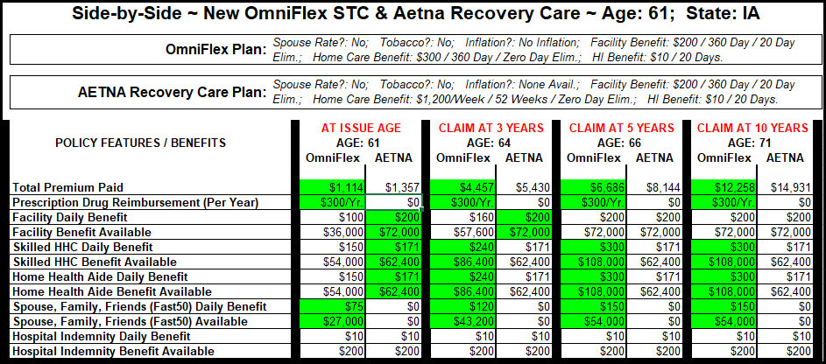
It’s About Benefits At Claim Time…
17.9% to 40% LESS Premium!
+73% HHC Pool!

Slide 16
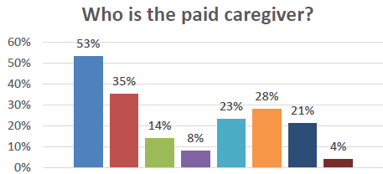
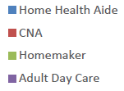
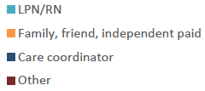
OmniFlex Shines vs. HHC Only Plans… especially,
Plans with Limited HH Aide & Family Benefits….
From 2015 to 2020, the number of unpaid family caregivers increased from 43.5 million to 53 million (over 20% of the adult population).¹
78% of adults living in the community needing long-term care have to depend on family and friends as their only source of help.²
³
¹“The State of Unpaid Family Caregiving in the U.S.,” myLifeSite, Web, April 18, 2021.
²“14 Alarming Statistics About Caregiving,” Bell & Associates Consulting, Web, January 11, 2022.
³CLTC Leadership Summit, September 12-13, 2022, Survey Analysis Conducted by ET Consulting, LLC.

Slide 17
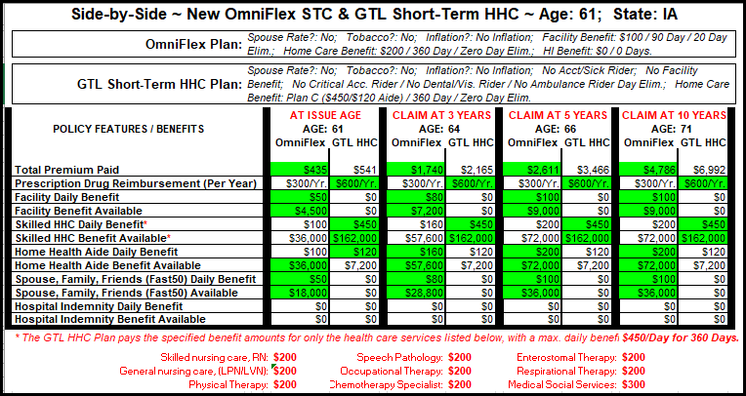
It’s About Benefits At Claim Time…
+500%
Aide
Pool!
+1000% Aide Pool!

Slide 18
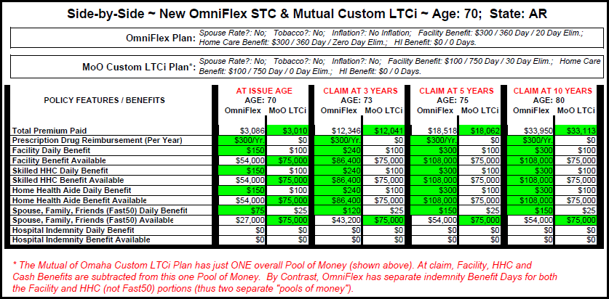
It’s About Benefits At Claim Time…
Up To 7.4% LESS Premium!
+188% Overall Pool!

Slide 19
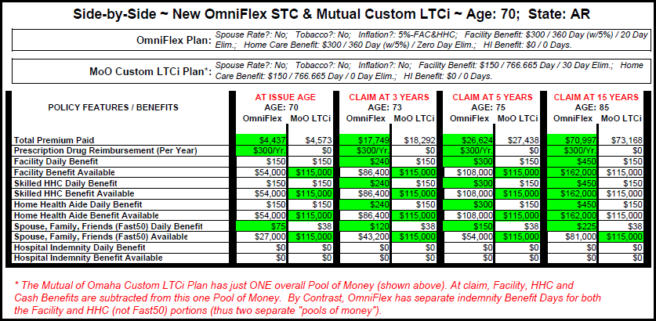
It’s About Benefits At Claim Time…
Up To 9.5% LESS Premium!
+88% /+182% Pool!

Slide 20
Say “Hello” to the Future of STC…
Let OmniFlex Help You Help More People!
Wide Underwriting
Flexible
Affordable
Facility Care
Medical Home Care
Full Days for HHC Aide
First-Day CASH!
Inflation Protection

Slide 21
It’s the Year to Help More People & Make More Money….
What Will
OmniFlex is planned for an official launch in mid-February!
Updated Pivot Presentation & InstaPivot UW tool before that!
2023
PLUS, look for another (2?) new STC plan(s), and a GREAT improved STC plan coming this year!
PLUS, if lucky, we are trying to help develop a completely new LTCi concept design… crossing our fingers on that one!
Bring?
Let Us Help You Make 2023 Your Best Production Year Ever!

Slide 22
Why STC Can Help Save the Industry !
Long Term Plans Plans
Short Term Care Plans
Minimum 2 Years (3, 4, 5+, Unlimited)
Inflation Can GREATLY Increase Carrier Exposure & Risk
Risk of Catastrophic Claims Affecting Entire Blocks
Much More Stringent UW Required
LONG Apps & Big Delays to Issue
Added Premium Needed to Cover Block
Complex with Certifications Needed
Maximum 1 Year – Caps the Indiv. Risk!
Limited Benefit Period Softens Inflation Blow to Carrier
Since Limited Benefit Period, No Real Catastrophic Claims
Underwriting Can Throw Net Wider
Shorter Apps & Very Fast Issue Times
Can Keep Very Flexible & Affordable
Much Simpler & No Special Certs.
STC Allows to go “Back to the Future” Again and Protect Older Prospects!

